Slide 1
Kenya 2013
Baylor Men’s Choir
Notes:
Title Page:
Welcome to Men’s Choir, Cashion, etc.
Talking about Kenya
Any other introduction

Slide 2
Testimonials
Why this trip can rock your world?
Why should you travel to Kenya with a music group?
How does God show up in Kenya?

Slide 3
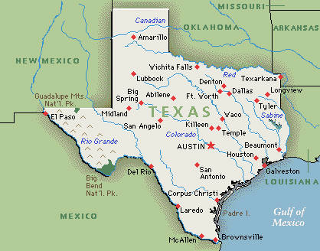
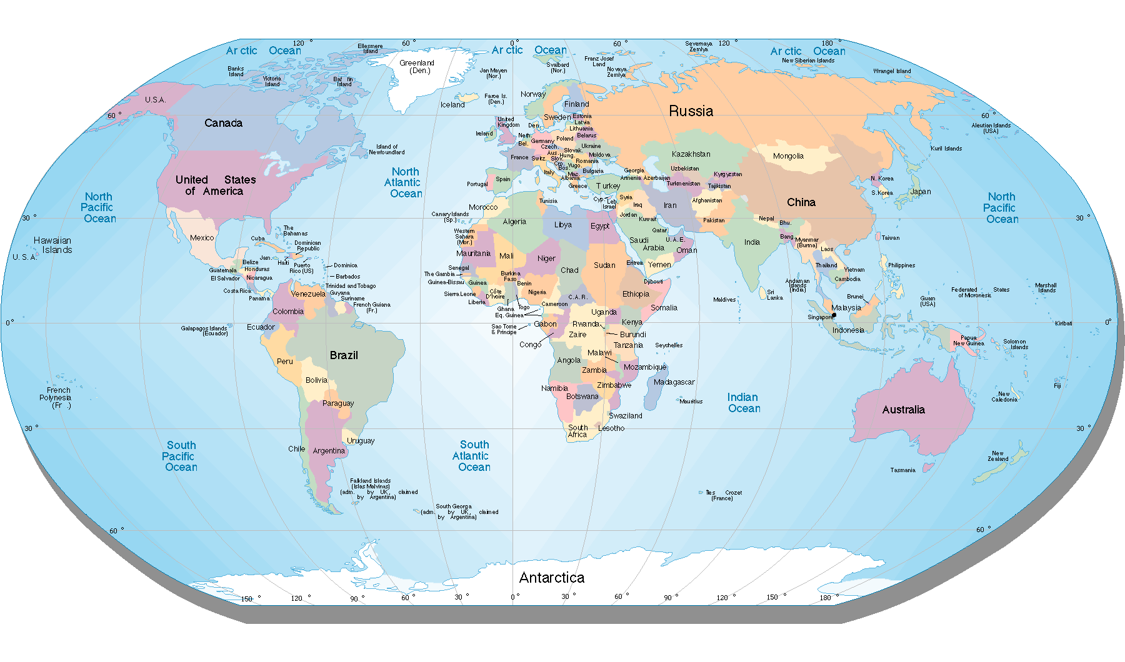

What will we be doing?
Notes:
Animations slide shows the travel plans for the first part of the trip (little silly but shows how we will travel)
Bus in Waco goes to Houston
Bus leaves and we take a plane from Houston to Dubai
Notice the flight path takes us over Europe (actual shortest distance because the world is round.
We get off that plane and get in a new plane that takes us to Kenya

Slide 4
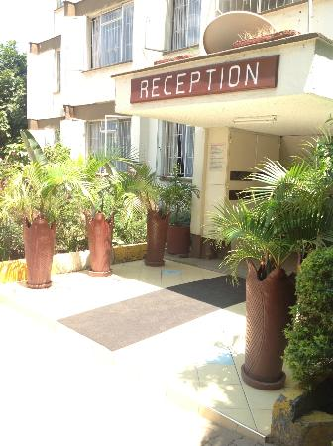
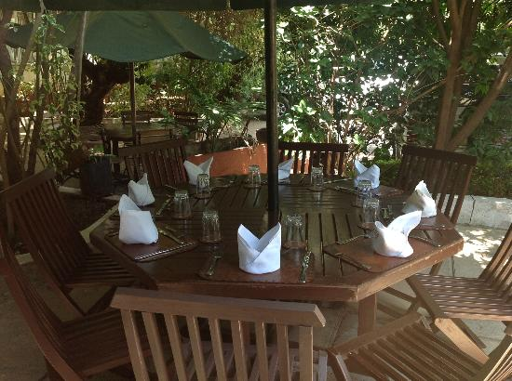
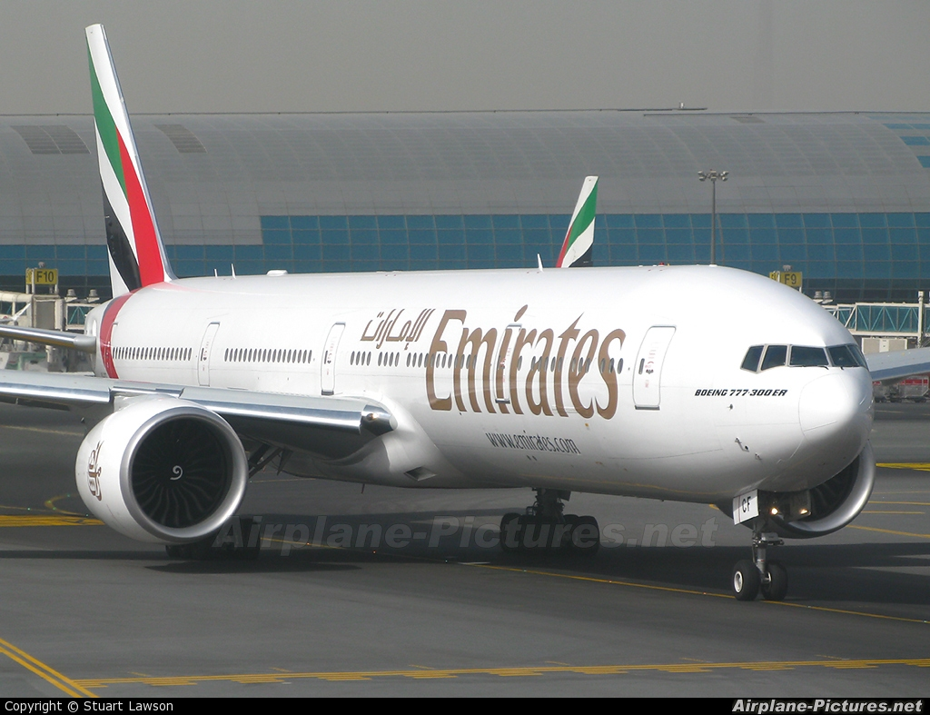
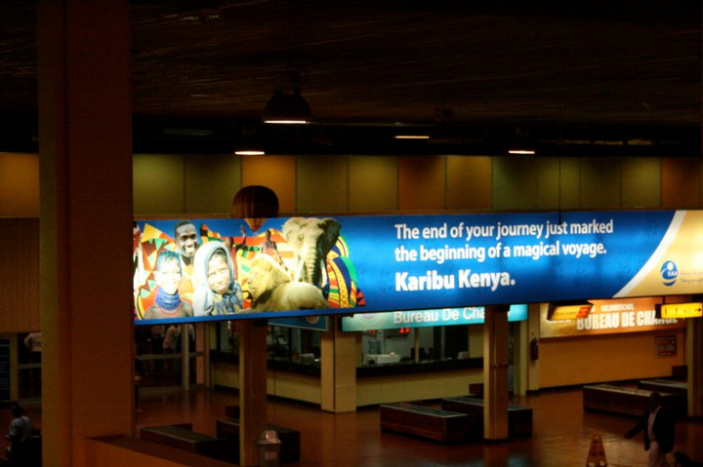
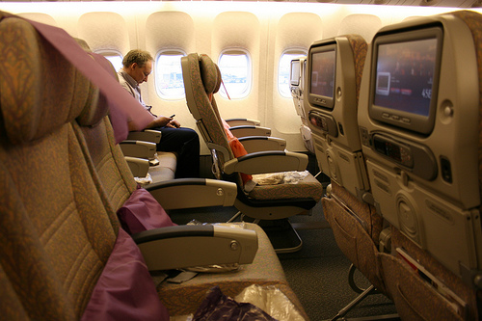
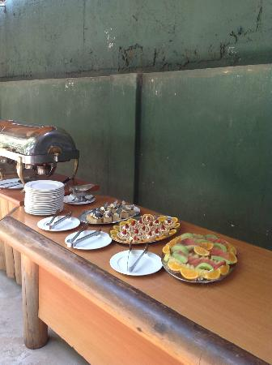
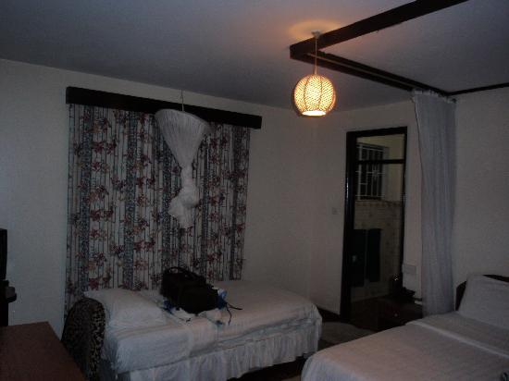

What will we be doing?
Sunday May 19
  Leave Baylor/Waco – morning
  Leave from Houston – afternoon/evening
Monday May 20
  Arrive in Dubai, U.A.B – morning
  Arrive in Kenya – evening
  Go to Grace House
Notes:
Pictures:
Airplane outside
Airplane inside
Arriving in Kenya
Outside Grace House
Food at Grace
Dining table at Grace
Room at Grace

Slide 5

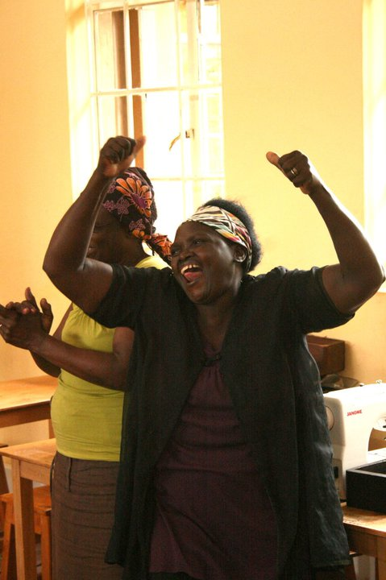
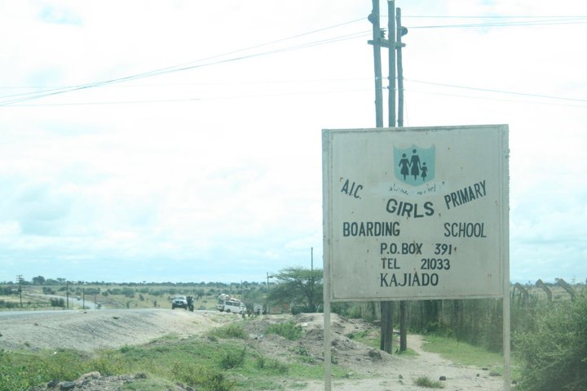
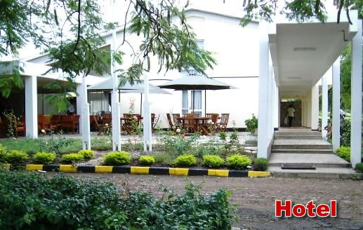
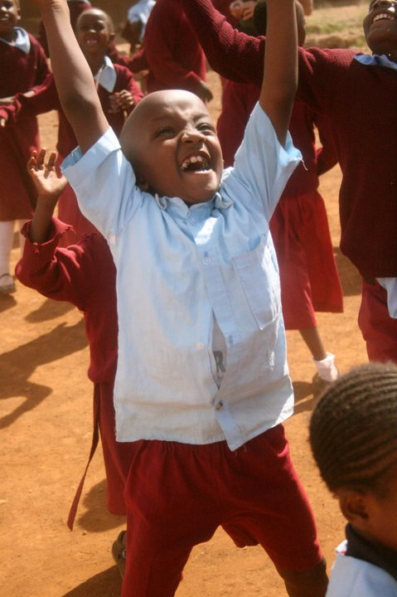
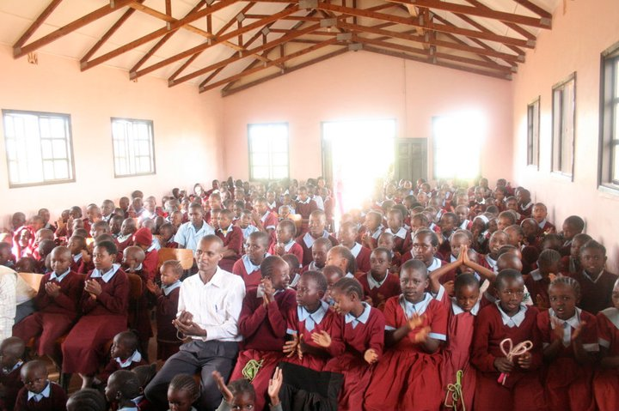
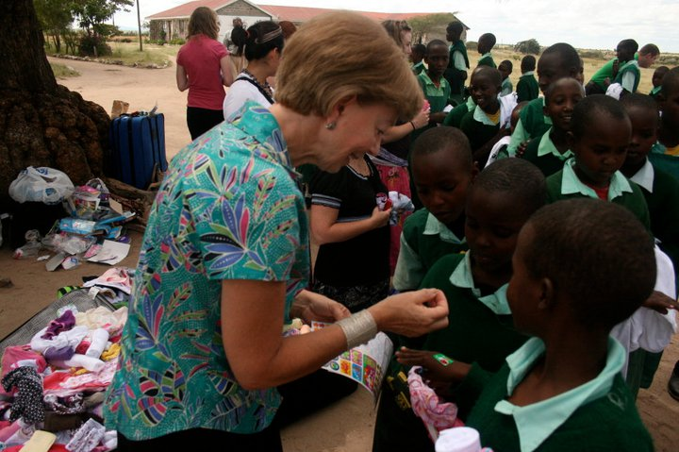

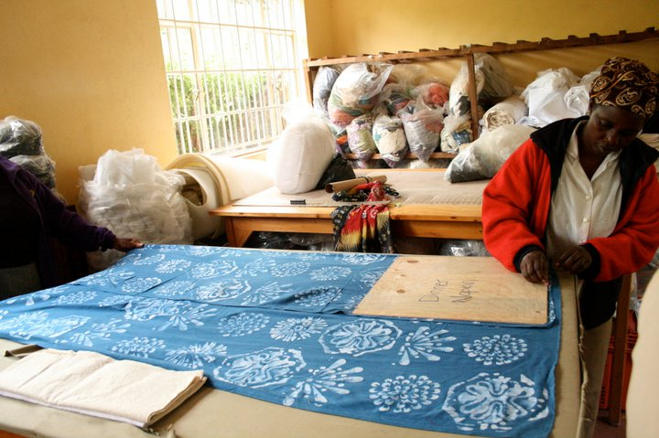
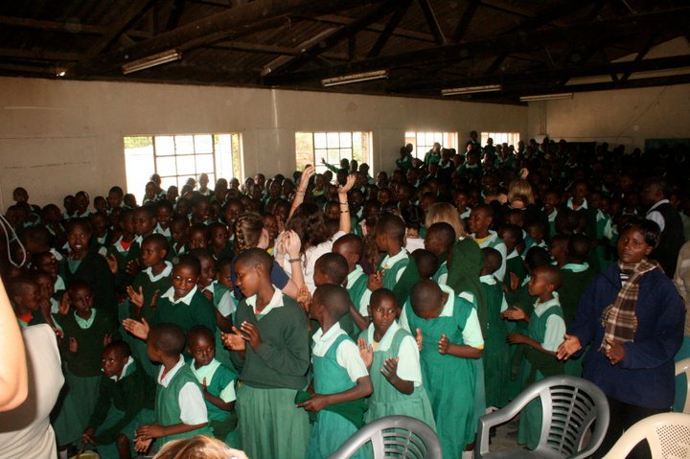
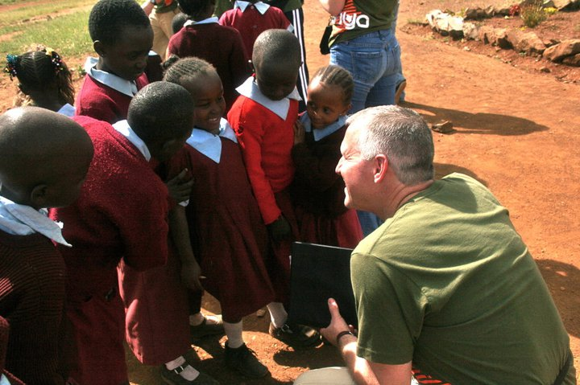
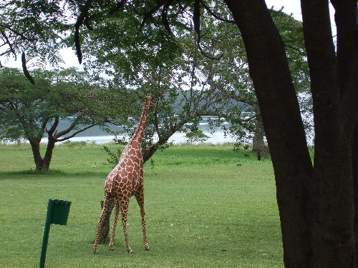
What will we be doing?
Tuesday May 21
  Visit Amani ya juu
  Sing for Buckner Children’s home
Wednesday May 22
  Visit A.I.C. Maasai Girl’s School
Thursday May 23
  Travel to Kendu Bay (Arts Festival there)
  Lodging in Homa Bay
Notes:
Pictures:
Amani ya juu
Greeter at Amani
Worker at Amani
Boy at Buckner
Dr. Bradley at Buckner
School in Buckner
Sign AIC
First Lady Alice Starr
Classroom at AIC
Hotel Homa
Giraffe Homa
Another Hotel Homa

Slide 6
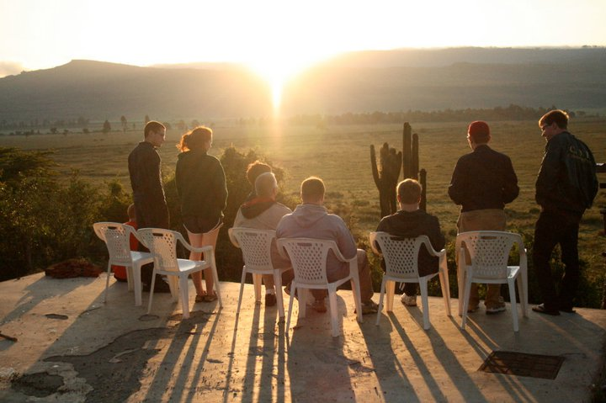
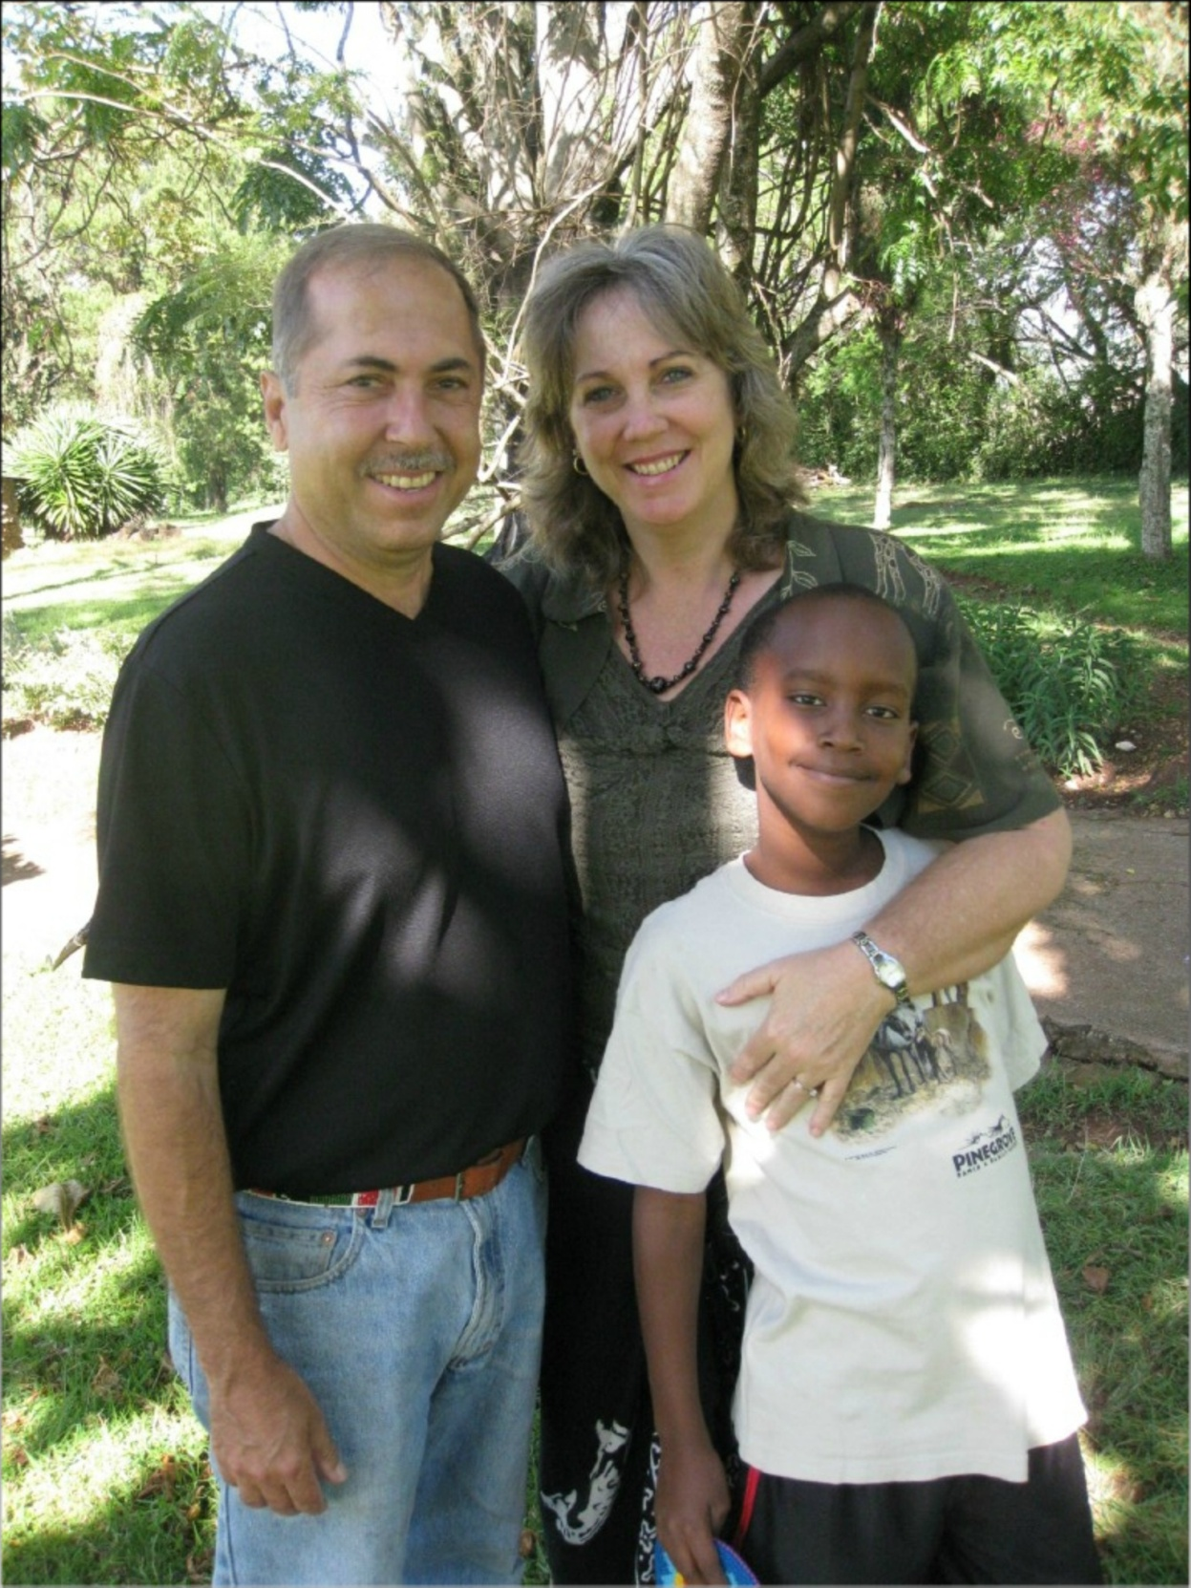
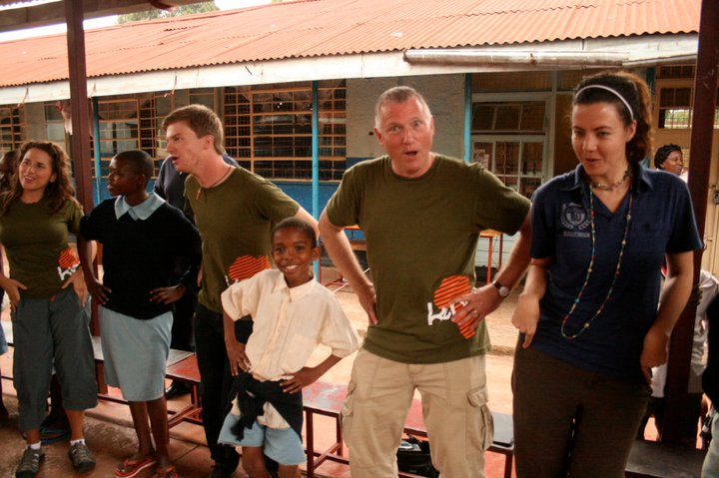
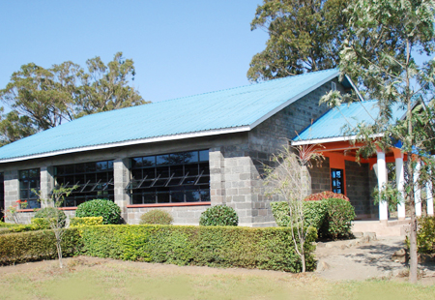
What will we be doing?
Friday May 24
  Work with local artisans
  Visit orphanage and other ministries
  Concert at Catholic Church, Homa Bay
Saturday May 25
  Leave Kendu Bay for Nakuru
  Arrive in Nakuru at Paul and Donna Tococos’
  Ministry in the late afternoon
  Lodging in the Tocco’s compound
Notes:
Picture:
What we might do at an orphanage
Paul, Donna, Josiah
Tocco’s Compound
Fellowship morning at Tocco’s

Slide 7
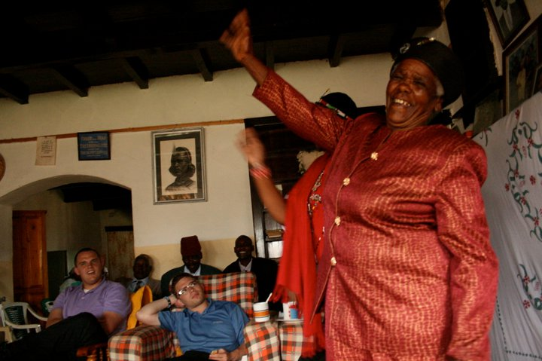
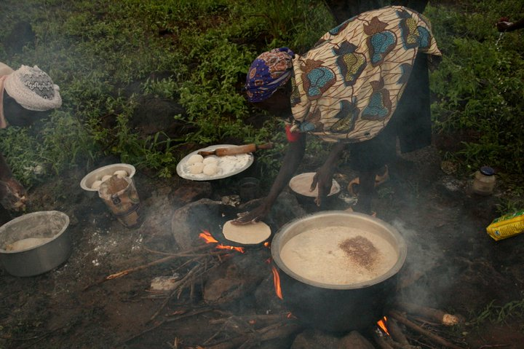
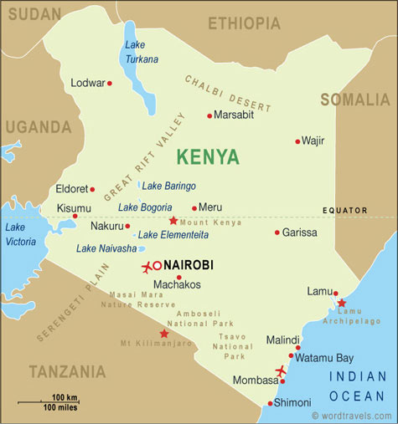
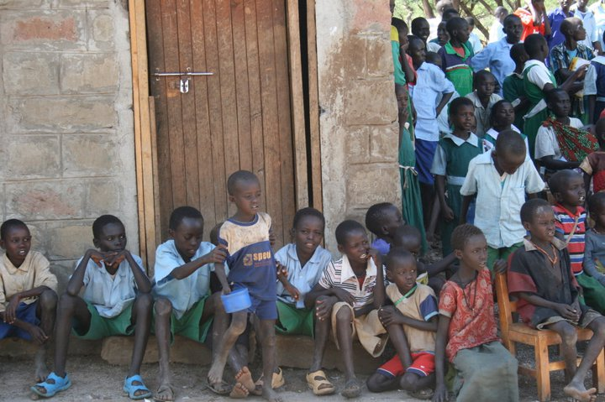
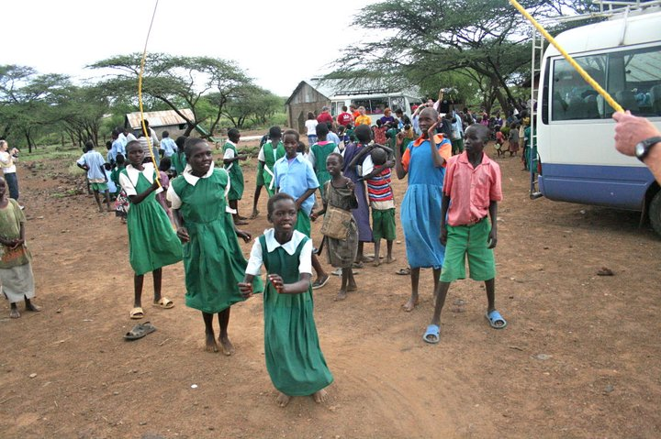
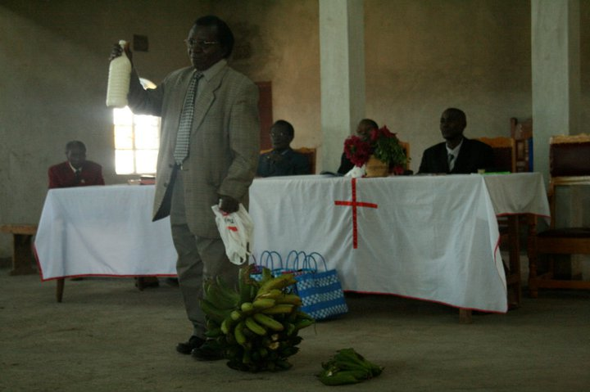
What will we be doing?
Sunday May 26
  Worship with CuCu’s congregation near Nakuru
  Lunch at the church or in a local home
  Evening with Toccos
Monday May 27
  Travel to Pokot Village
  Concert and ministry in the evening
  Night in Pokot village
Notes:
Pictures:
Offering
CuCu
Map of Kenya for recap of travel(click for arrow for each town we have travelled)

Slide 8
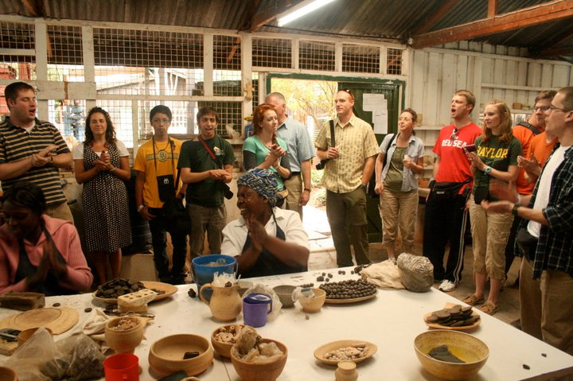
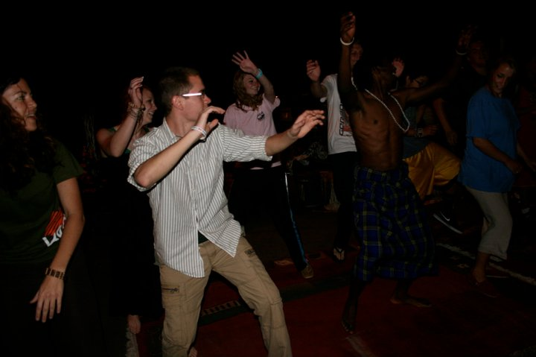
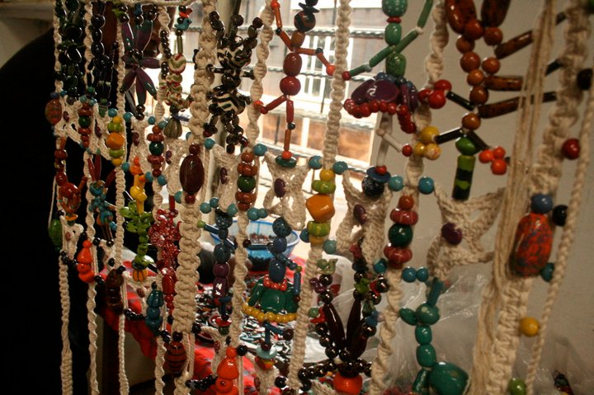
What will we be doing?
Tuesday May 28
  Return to Nakuru
  Stop for concerts en-route
  Possible ministry in the late afternoon
  Night at Tocco’s
Wednesday May 29
  Return to Nairobi (159 kms, 2.5 hours)
  Trip to the Maasai Market
  Visit Kazuri Bead Factory
Notes:
Picture:
Singing at Kazuri
Beads at Kazuri
Dance

Slide 9
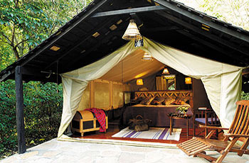
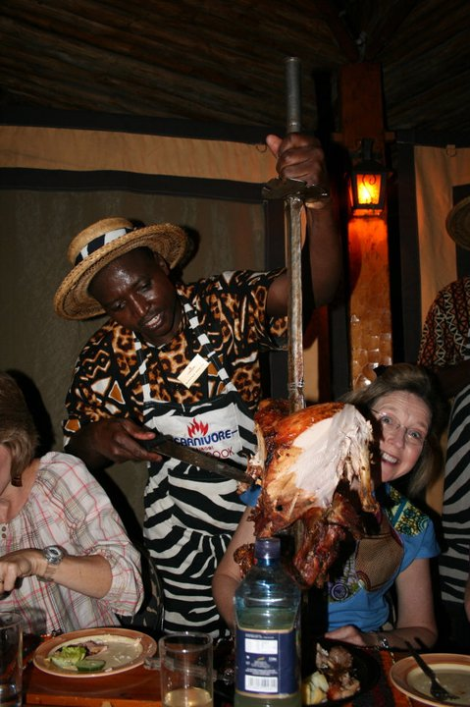
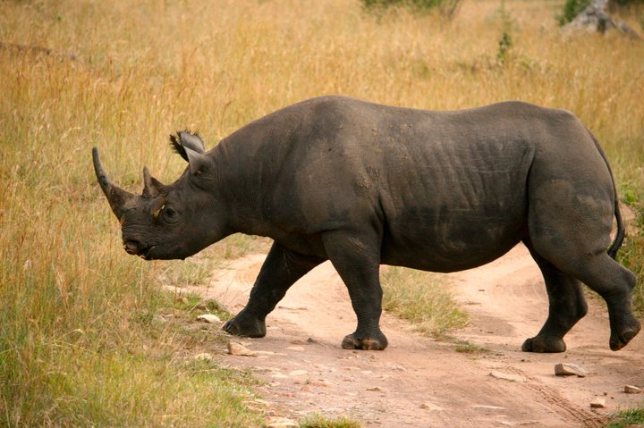
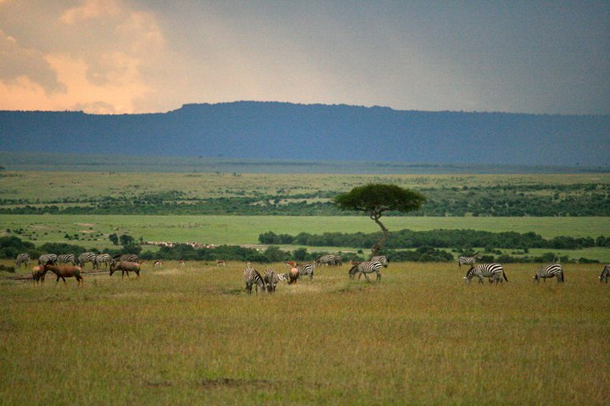
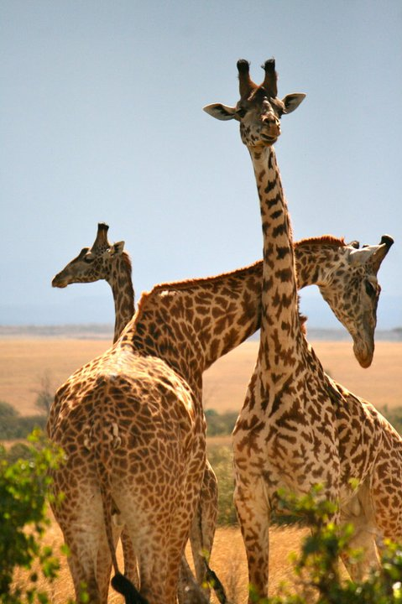
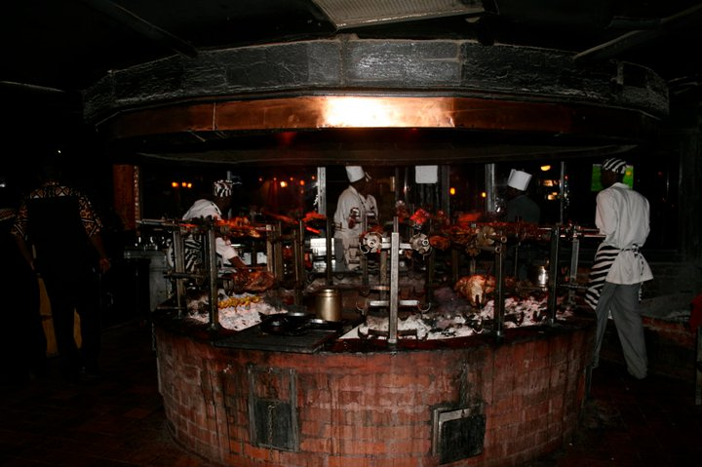
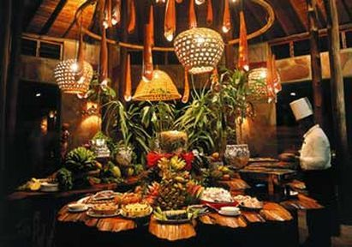
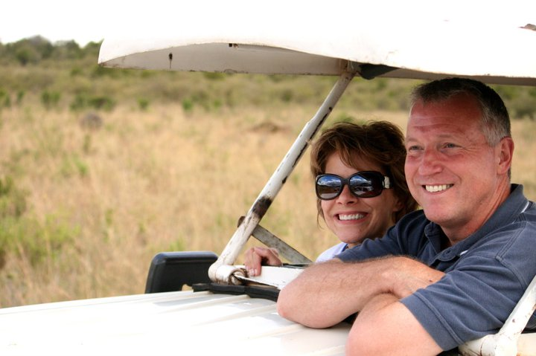
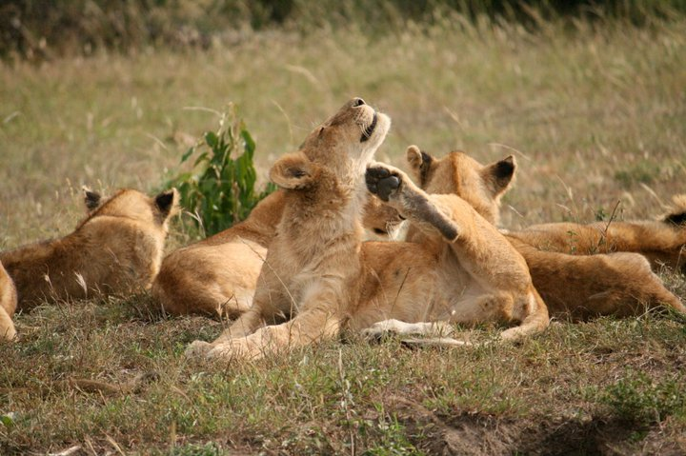
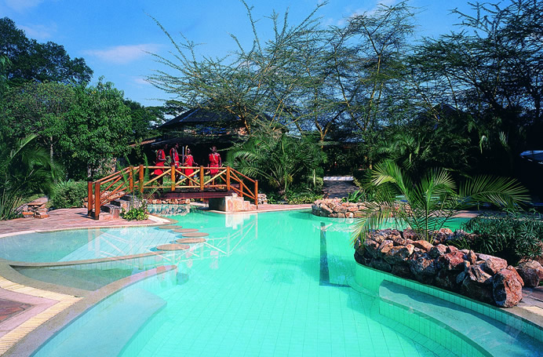
What will we be doing?
Thursday May 30
  Travel to Masaai Mara for Safari
  Game drives in the afternoon
Friday May 31
  Game drives in the Masaai Mara
Saturday June 1
  Return to Nairobi from Safari
  Meal at Carnivore
Notes:
Pictures:
Tent at Maasai Mara
Pool
Food
Disappear
4. Rhino
5. Giraffe
6. Bradleys (Disappear)
7. Lions
8. Zebras and Antelope
9. Carnivore carver
10. Meat

Slide 10
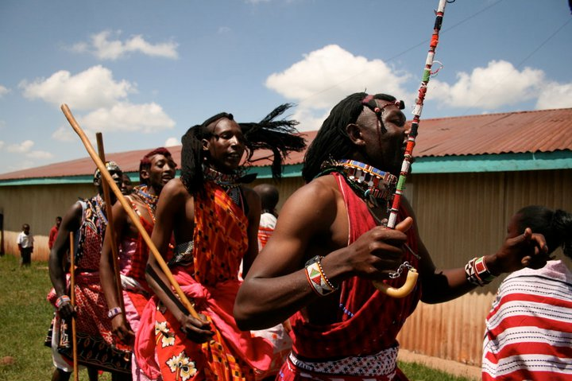
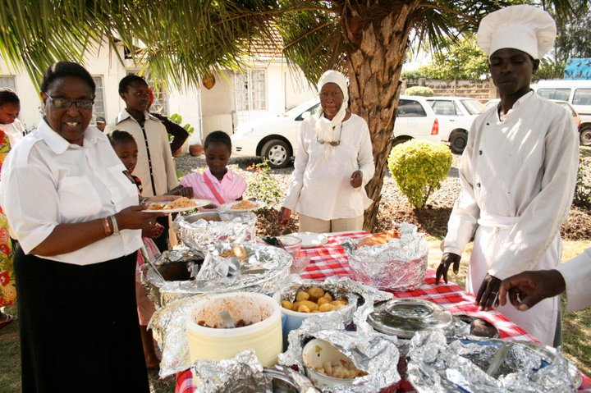
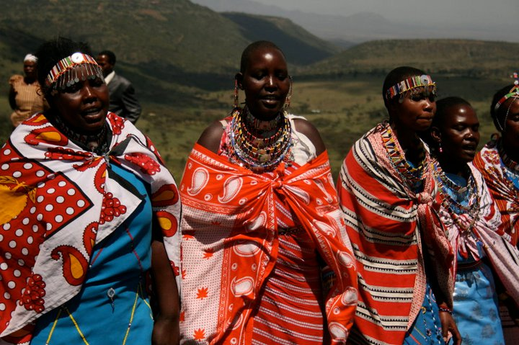
What will we be doing?
Sunday, June 2
  Worship with Zippy’s church at 10:00
  Travel to rural church at 12:00 for ministry there
  Lunch and fellowship at home of Zipporah and Daniel Sindiyo to follow
  Leave Nairobi – late evening
Monday, June 3
  Arrive Houston – afternoon/evening
  Arrive Waco – late evening
Notes:
Picture:
Maasai women
Maasai men
Lunch

Slide 11
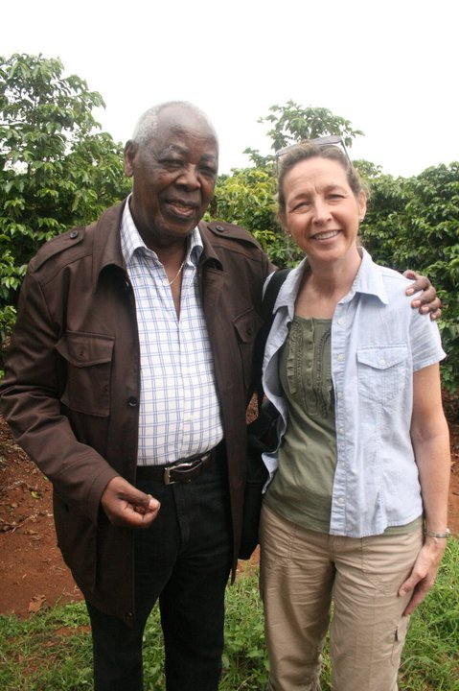
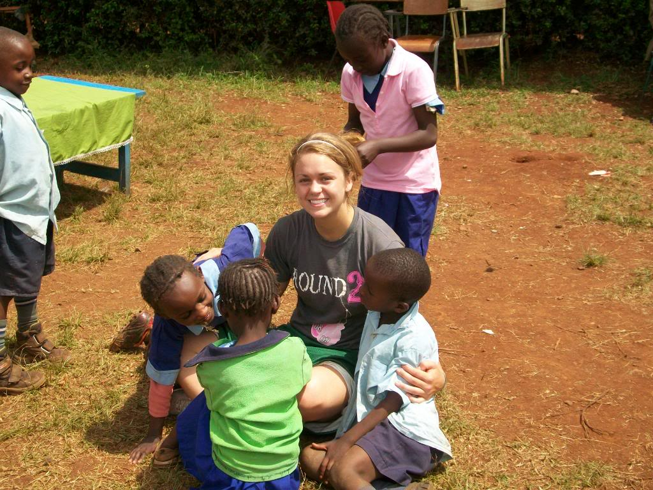
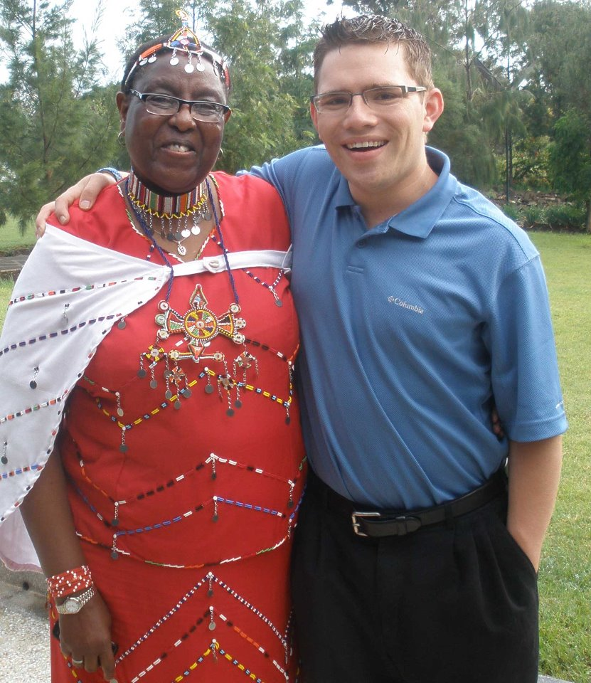
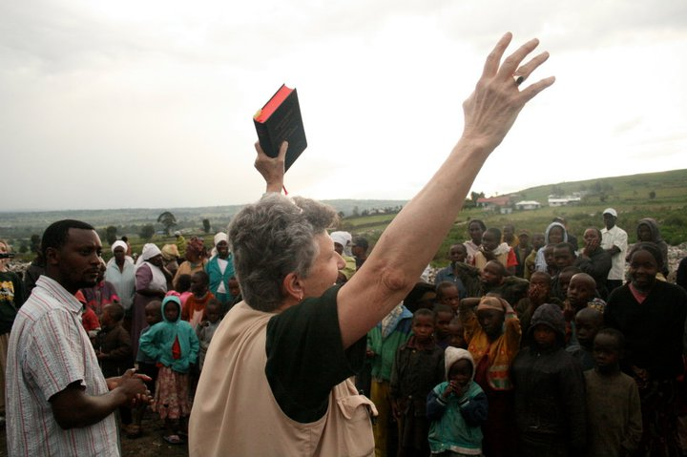
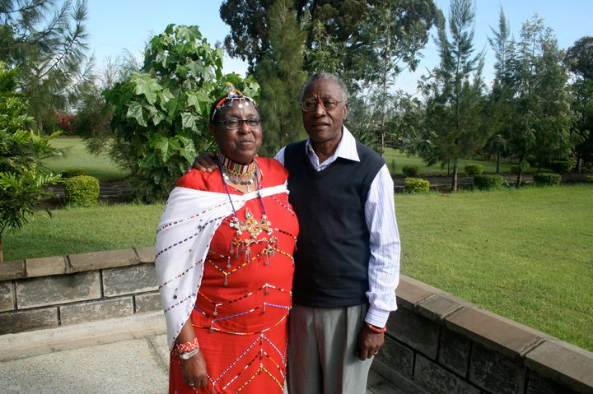




Who will be going with us?
Notes:
Dr. Bradley
Sharyn
Lynn
Zippy and Daniel
Brenda
Chris
[Next few may not actually be going, but have gone]
Ashley (pretty girl)
Lindsay Palmer (women’s basketball)
Terrance Ganaway

Slide 12
How will we stay safe?
International SOS
Baylor’s Risk Management
Safe food and water
Experienced leadership and Baylor Spiritual Life staff
Notes:
Baylor pays for international SOS (get a helicopter and fly us out)
Gabe, Travis and Will did not once go hungry or thirsty and were not sick (Will was a little, but that was just travel)
Dr. Bradley’s 4th trip. Brenda, Sharyn, Lynn, Chris have all gone. Baylor Spiritual Life sends groups every year

Slide 13
How much will the trip cost?
$3200

Slide 14


How will we raise the money
Group Fundraising
  T-shirts
  Recordings
  Africa Bracelets
  Concerts and donations
Individual fundraising
  Letter
  Christmas Gifts
  Payment Schedule
Notes:
Click for group, picture of bracelets (talk of stretchy band as well as this kind) and individual

Slide 15
What immunizations will I need?
Typhoid
Polio
Yellow Fever
Malaria (pills usually)
All are available at Health Department and Baylor Health Services
Not included in cost of the trip

Slide 16

Sic ‘em!

Slide 17
Zippy and Daniel
Notes:
Click for sound

Slide 18

Questions?

